Slide 1
Analysis of Features affecting High School dropout Rates
Data mining 5310
Team 4
Daniel Avalos
Ruqia Osman
Mudiha Wazirali

Slide 2


Machine Learning as an Investigative tool for dropout rates
High school dropout rates are affected by many different features
Question is, what features affect dropout rates?
Which groups are affected the most by these features?
Does a diverse district make a difference in helping to reduce dropout rates?
Gaining knowledge on the driving features and understanding their impact will help guide the conversation towards more productive solutions in bringing down these rates
Machine learning algorithms will help to clarify the relationships or lack of between different features and dropout rates
Source: https://library.cqpress.com

Slide 3
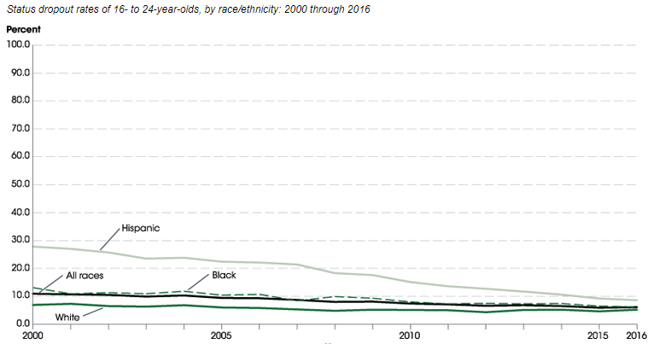
What drives our desire to explore dropout rates and what are our goals?
Personal experience as students from minority groups and one of us as an educator; along with curiosity about features that might affect dropout rates, motivates us to explore this topic:
As of 2014, more than 700,000 teens still drop out each year
From 2000 to 2016, nationwide dropout rates decreased significantly across the board for white, black, and Hispanic student groups
Features such as race, students’ movements, and special needs have affected dropout rates
It is predicted that today’s minorities will comprise the majority of population in 2045
Houston is in the most diverse large city in the nation.
Source: https://nces.ed.gov

Slide 4
What drives our desire to explore dropout rates and what are our goals?
Personal experience as students from minority groups and one of us as an educator; along with
curiosity about factors that might affect dropout rates, us to explore this topic:
MicroAnalysis: We would like to explore the strength of the relationship between these features and dropout rates in a diverse city such as Houston.
We want to use machine learning algorithms to identify the strong and weak correlation between various features leading to dropout rates
MacroAnalysis: We will explore how diversity affects these features in Houston region school districts, and apply this knowledge to the generalization of how diversity will affect the nations’ dropout rates
Source: https://nces.ed.gov

Slide 5
Research questions & Hypothesis
Question: The affect a diverse district plays on dropout rates
Hypothesis: We believe diversity does have a positive impact in decreasing dropout rates
Test through Linear Regression Analysis the following features’ relationship to dropout rates:
Race
Retention
Special Needs (504, Special Education (IEP), and English Language Learner (ELL)) services
Gender
Movers (Migrants, Homeless, Immigrants)

Slide 6
Data Sources
Texas Education Agency (TEA):
Dropout Numbers: https://tea.texas.gov/acctres/drop_annual/1516/level.html
Houston Region Numbers:
Overall: https://tea.texas.gov/acctres/drop_annual/1516/level.html
Race/Ethnicity, Economic Status, Gender, and Grade Span: https://rptsvr1.tea.texas.gov/cgi/sas/broker?_service=marykay&_program=acctres.armast.sas&prgopt=drop_annual%2F1516%2Fdistsum_demo.sas&year4=1516&year2=16&topic=dropout&search=district&namenum=079907
National Center for Education Statistics:
Datatools: https://nces.ed.gov/datatools/

Slide 7

Data Preprocessing & Modeling
Data preprocessing will be done with R coding
Data cleaning will be done by:
Handling missing values
Removing unidentified class labels
Misleading features will be identified and removed
Features either not needed or repeated will be removed
Clear names will be assigned to features being studied in the training and testing model
Normalization or standardization will be performed as needed
Regression Analysis will be applied to find the relationship between the features and dropout rates
Generalization: predict whether diversity plays any role in affecting dropout rates nationwide
This Photo by Unknown Author is licensed under CC BY-SA-NC

Slide 8
Data Analysis Approach being utilized
Clearly Defined Questions: We would like to measure various features that affect dropout rates defined earlier in the proposal
Decision on what and how we will measure our data:
Collect data from national and state level education agencies and other reliable sources
Measure the correlation within the features with each other
Measure driving features by the strength of their correlation to dropout rates
3. Analyze Data:
Use a training set from the collected data to model the algorithms
Check with residual analysis to check the strength of our model
Find the importance of each feature.

Slide 9
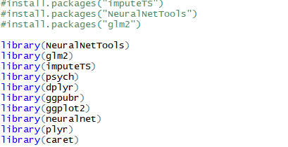
Packages & libraries utilized

Slide 10
Is there sufficient data?
Fort Bend: Data included only 14 schools
Houston Region: Data spanned a wider region with 234 schools
Result: Data is varied and provides a clearer picture of features’ impacts on dropout rates

Slide 11
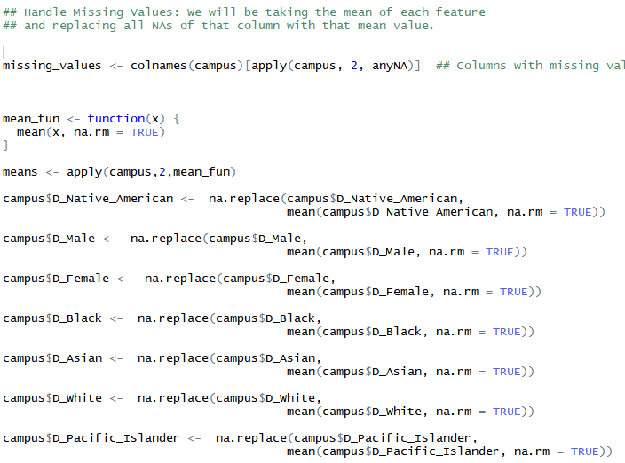
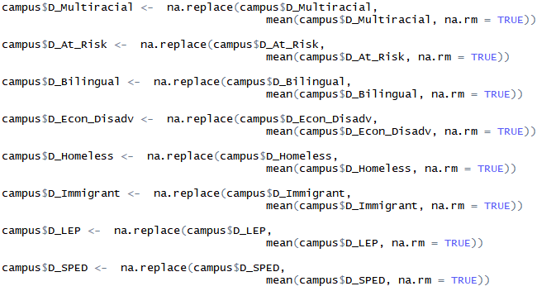
Handling missing values

Slide 12

CORRELATION between features
This Photo by Unknown Author is licensed under CC BY-ND

Slide 13
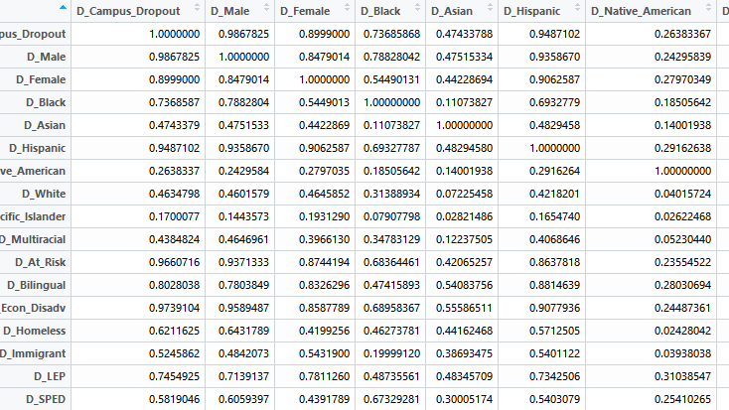
Notes:
Our data was weighted on sub-population, so male and female are generalizations of the other features. So we removed both features.
Hispanic, economically disadg, and at risk have highest correlations

Slide 14
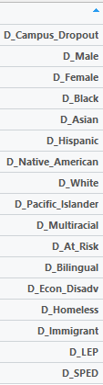
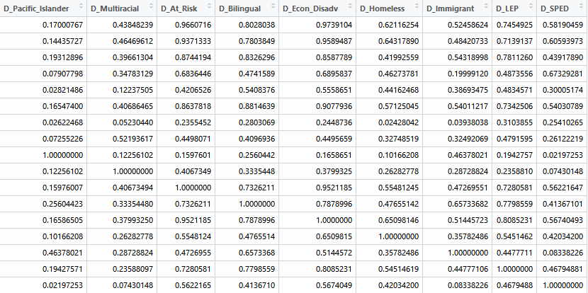

Slide 15
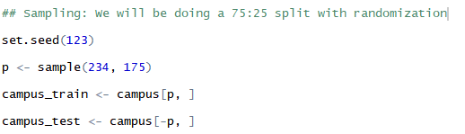
Sampling

Slide 16
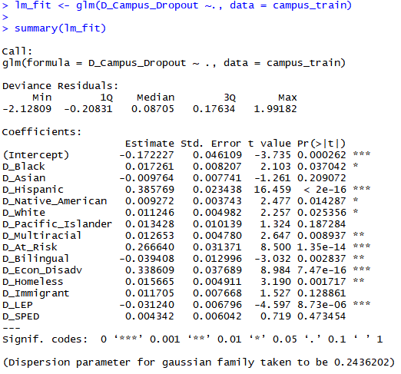
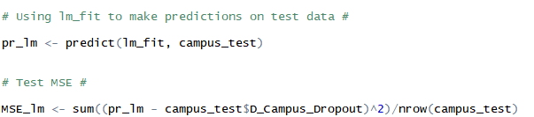

Regression Model fit & summary

Slide 17
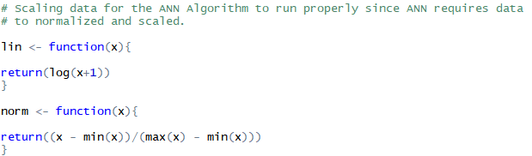
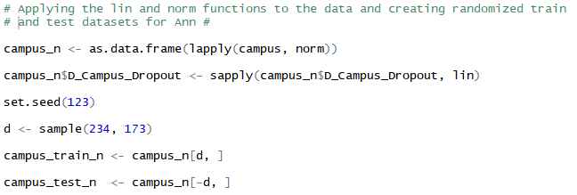

Slide 18
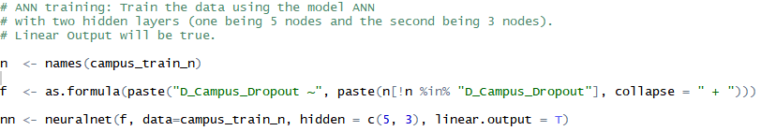
Neural network regression

Slide 19
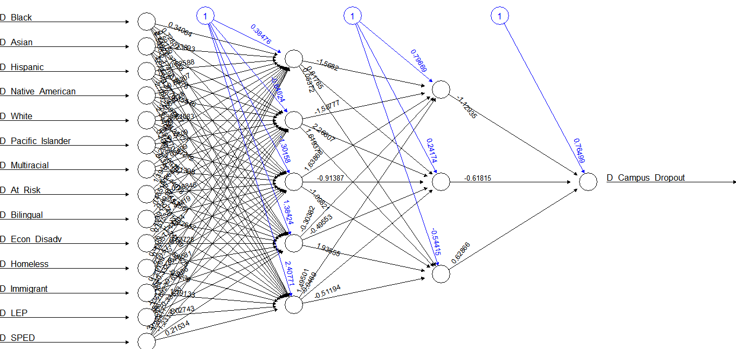

Slide 20

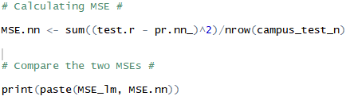

Slide 21
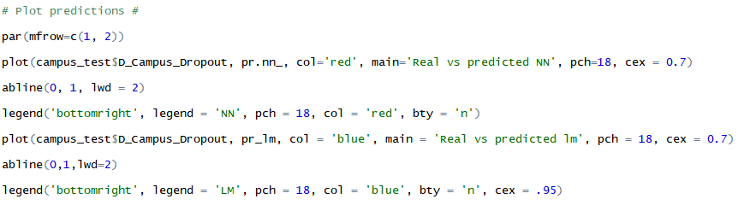

Slide 22
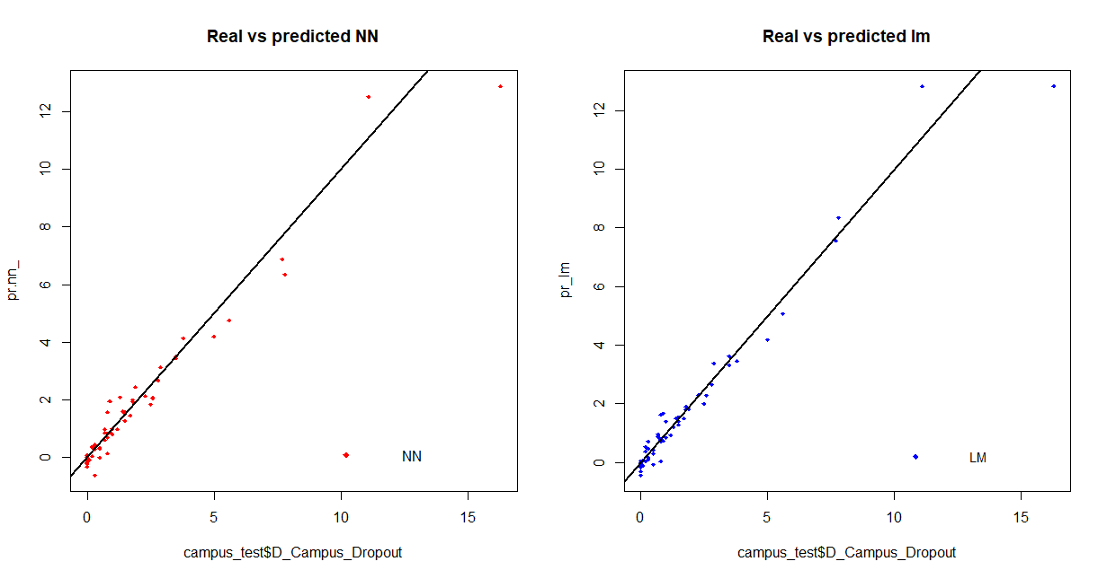

Slide 23
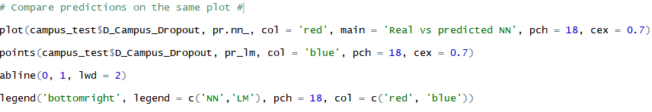
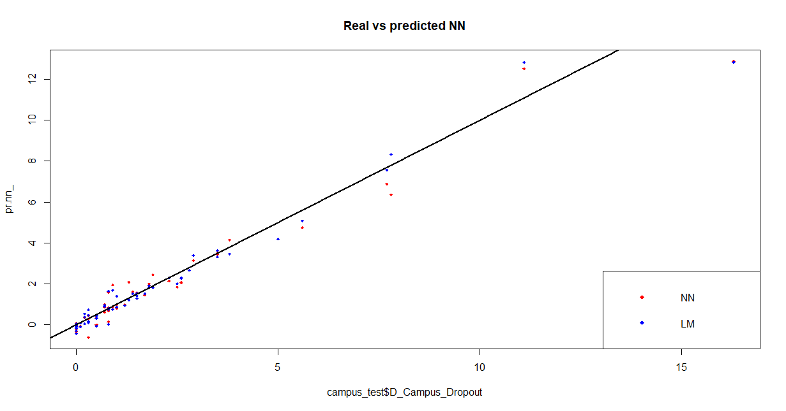

Slide 24
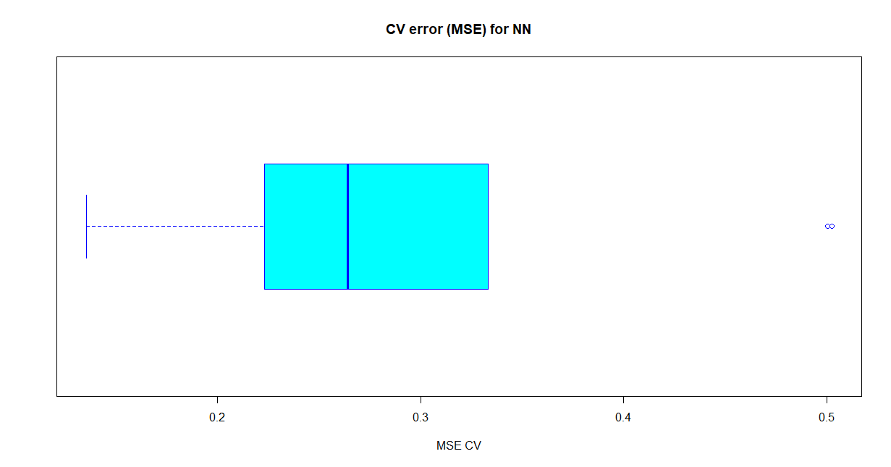
10-Fold Cross Validation of MSE
Using the boot library, we used the function cv.glm which is cross validation for generalized linear models
We used this for both the regression model and the neural network model
We used a for loop to find each MSE, and took the average

Slide 25
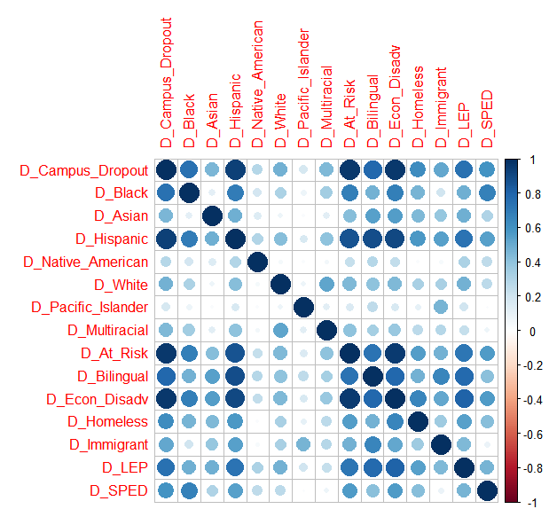
CORRELATION
VISUALIZATION

Slide 26
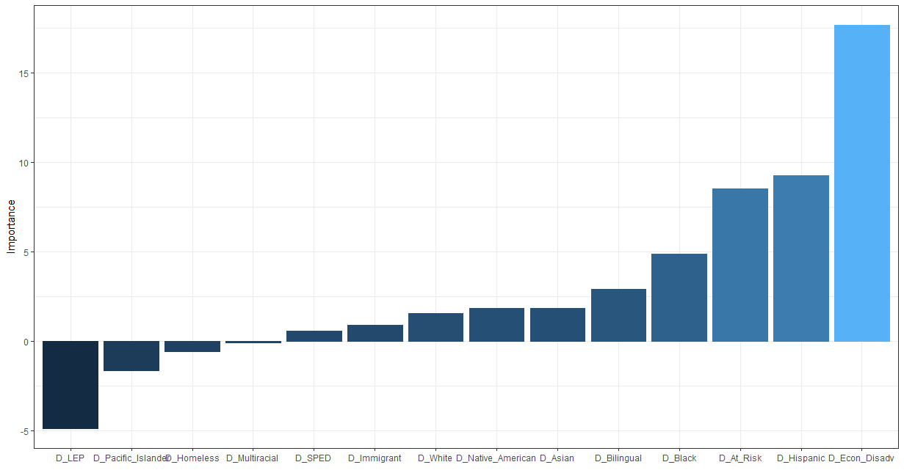
Importance of each feature = overall results
Notes:
We used functions from a package called neuralnettools. This particular function displays the importance of input variables in our neural network.

Slide 27
Macroanalysis
Generalize model to the national drop out rates because the US is becoming a more diverse country as well
Our recommendation is to address the needs of the economically disadvantaged and at risk students
Also, since the Hispanic population is experiencing the greatest population growth, we recommend exploring better ways to allow them to integrate into the education system

